Slide 1
Angular
Building an Angular Application

Slide 2
By the end of this topic you will learn how to setup an angular application and build your first components
This chapter will help you understand the following
topics

Slide 3
Angular
1
Create the application

Slide 4
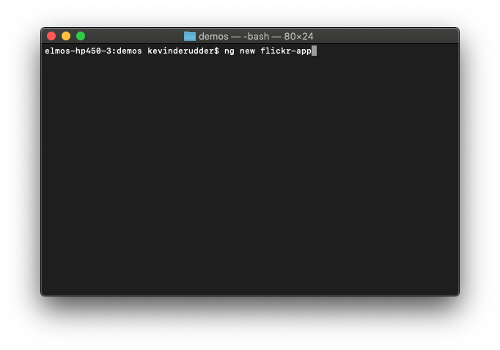
Create the application
Angular CLI

Slide 5
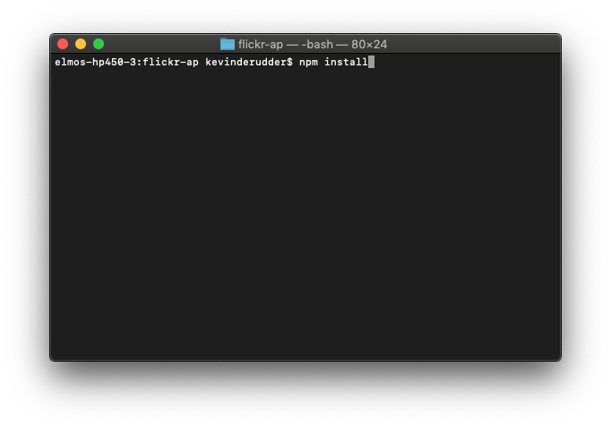
Install dependencies
npm install

Slide 6
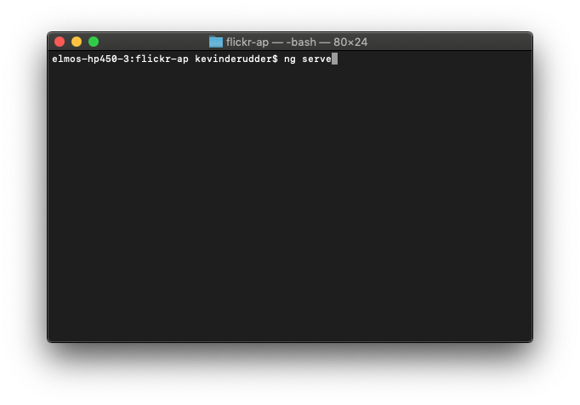
Run the application
ng serve

Slide 7
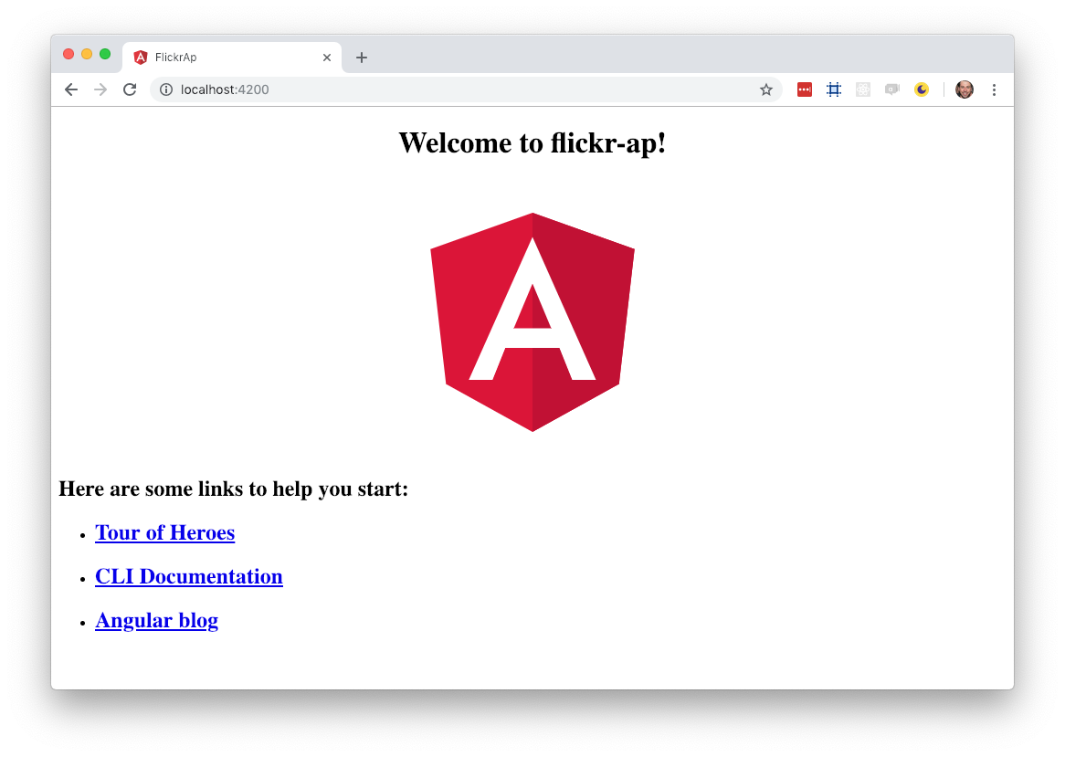

Slide 8
Angular
2
Make your first component

Slide 9
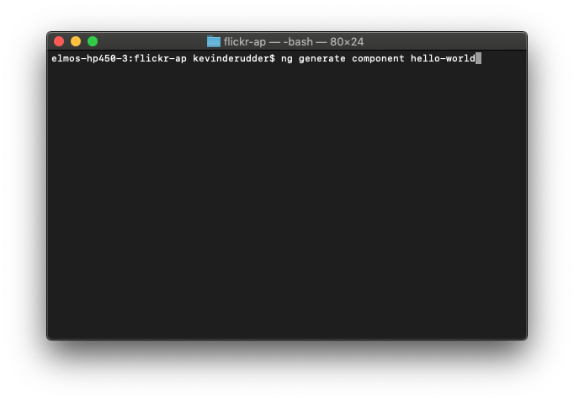
What would dev-live be without hello-world
ng generate component hello-world

Slide 10
What would dev-life be without hello-world
import { Component, OnInit } from '@angular/core';
@Component({
selector: 'app-hello-world',
templateUrl: './hello-world.component.html',
styleUrls: ['./hello-world.component.scss']
})
export class HelloWorldComponent implements OnInit {
constructor() { }
ngOnInit() {
}
}

Slide 11
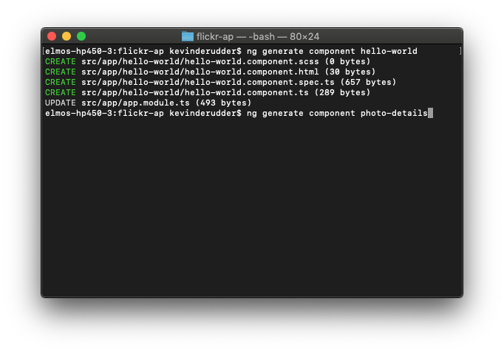
Create a photo-details component

Slide 12
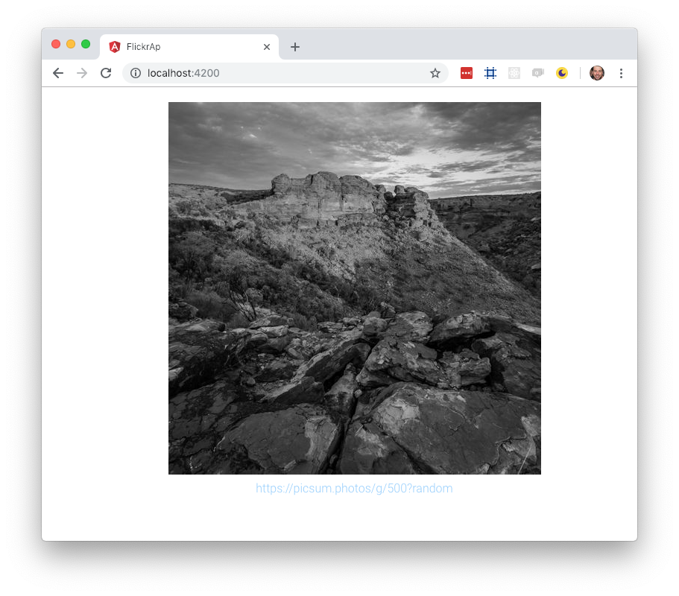
Create a photo-details component

Slide 13
Angular
3
Generate model

Slide 14

Generate model
ng generate model <model_name>

Slide 15
Photo model
export interface IPhoto {
url: string;
title: string;
toUrl():string;
}
export class Photo implements Photo{
constructor(public url:string, public title:string){}
toUrl():string{
return this.title;
}
}

Slide 16
Angular
4
Models and Components

Slide 17
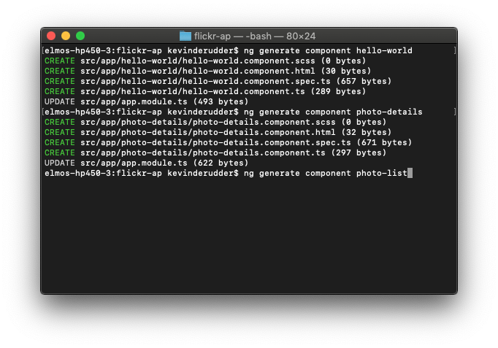
Make a photo-list component

Slide 18
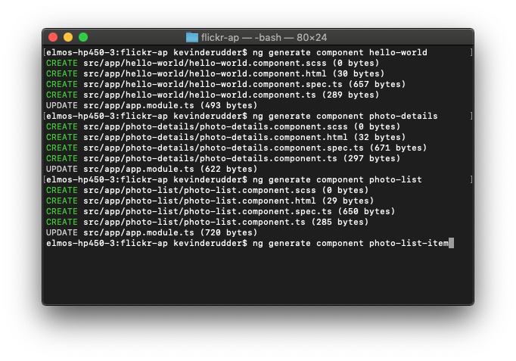
Make a photo-list-item component

Slide 19
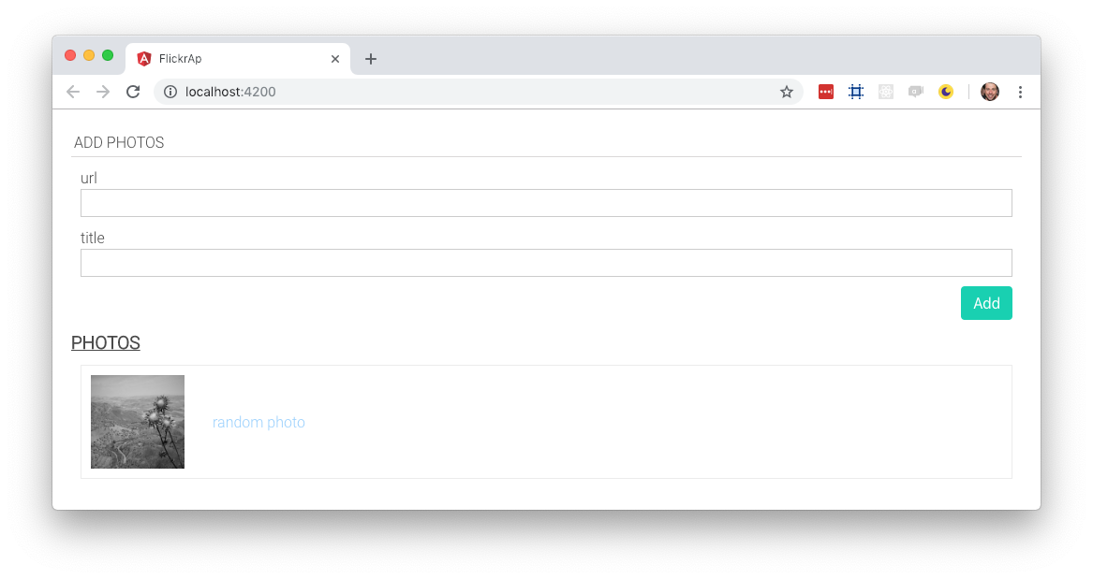

Slide 20
Bind model to component
import { Photo } from "./../models/photo";
import { Component, OnInit } from "@angular/core";
@Component({
selector: "app-photo-list-item",
templateUrl: "./photo-list-item.component.html",
styleUrls: ["./photo-list-item.component.scss"]
})
export class PhotoListItemComponent implements OnInit {
photo: Photo = new Photo(
"https://picsum.photos/g/500?random",
"random photo"
);
constructor() {}
ngOnInit() {}
}

Slide 21
Bind model to component
<div class="c-photo-list-item">
<figure>
<img class="c-photo-details__img"
src="{{photo.url}}"
alt="{{photo.title}}"
title="{{photo.title}}" />
<figcaption>
<span class="c-photo-details__url">{{photo.title}}</span>
</figcaption>
</figure>
</div>

Slide 22
Angular
4
Input parameters

Slide 23
Pass parameter to child component
Use Input in child component
import { Component, OnInit, Input } from "@angular/core";
@Component({/*…*/})
export class PhotoListItemComponent implements OnInit {
@Input() photo:Photo;
constructor() {}
ngOnInit() {}
}

Slide 24
Pass parameter to child component
Use [attribute] to pass object to child
export class PhotoListComponent{
photo: Photo = new Photo(
"https://picsum.photos/g/500?random",
"random photo"
);
constructor() {}
}
<h2>Photos</h2>
<ul>
<li>
<app-photo-list-item [photo]="photo"></app-photo-list-item>
</li>
</ul>

Slide 26
Angular
5
Directives

Slide 27
ngFor
Load multiple photos
photos: Photo[] = [
new Photo("https://picsum.photos/g/500?random","random photo"),
new Photo("https://picsum.photos/g/500?random","random photo"),
new Photo("https://picsum.photos/g/500?random","random photo")
];
<ul>
<li *ngFor="let p of photos">
<app-photo-list-item [photo]="p"></app-photo-list-item>
</li>
</ul>

Slide 28
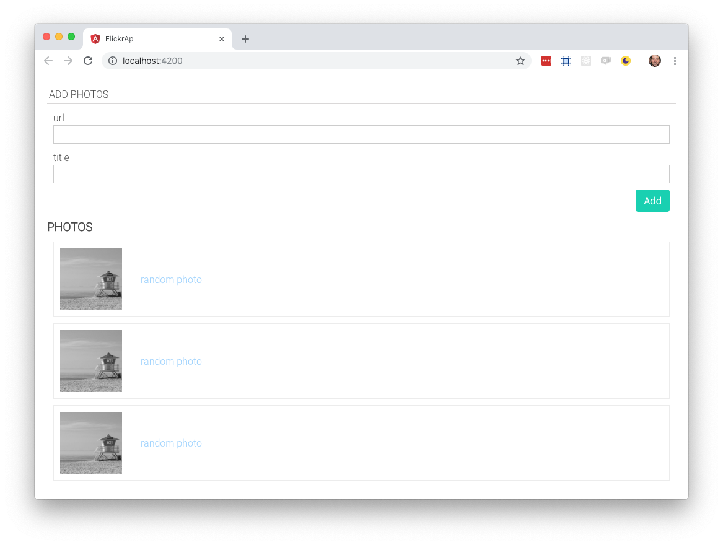

Slide 29
ngIf
Only show the photos section when there are photos available
<h2>Photos</h2>
<p *ngIf="photos && photos.length <=0">
No saved photos to display
</p>
<ul *ngIf="photos && photos.length > 0">
<li *ngFor="let p of photos">
<app-photo-list-item [photo]="p"></app-photo-list-item>
</li>
</ul>

Slide 30
Angular
6
Events

Slide 31
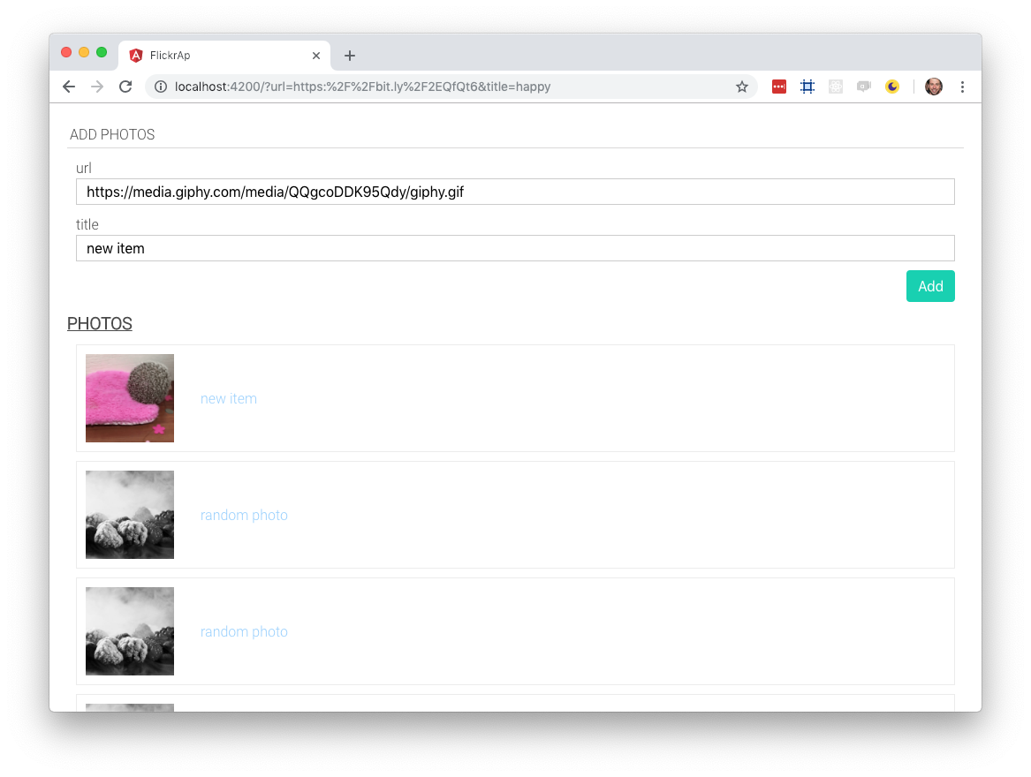
Add images by completing the form

Slide 32
Add images by completing the form
<div class="c-form__actions">
<button class="button is-primary"
(click)="addImage(newLink, newTitle)">
Add
</button>
</div>
addImage(newLink, newTitle){
this.photos.unshift(
new Photo(newLink.value, newTitle.value)
)
return false;
}

Slide 33
Angular
7
Components output

Slide 34
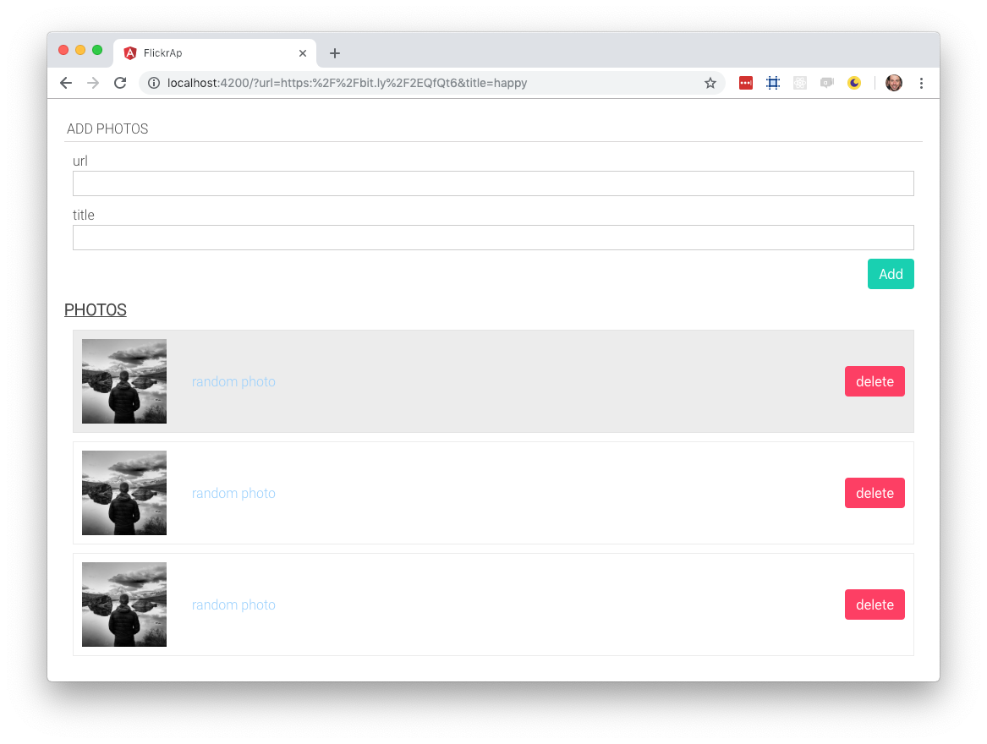

Slide 35
Send data from your component to the world
Use @Output() binding
Specify outputs in the @Component configuration
Attach an EventEmitter to the output property
Emit the event from the EventEmmiter
EventEmitter
An object that helps implement the Observer Pattern

Slide 36
Emit delete event from the child component
import { Photo } from "./../models/photo";
import { Component, OnInit, Input, Output, EventEmitter } from "@angular/core";
@Component({/* … */})
export class PhotoListItemComponent {
@Input() photo:Photo;
@Output() delete: EventEmitter<Photo>;
constructor() {
this.delete = new EventEmitter();
}
deletePhoto(){
this.delete.emit(this.photo);
}
}

Slide 37
Handle event in the outside world
<ul *ngIf="photos && photos.length > 0">
<li *ngFor="let p of photos">
<app-photo-list-item [photo]="p"
(delete)="deletePhoto($event)"></app-photo-list-item>
</li>
</ul>

Slide 38
Angular
8
Error handling

Slide 39
Error handling
Essential in building robust applications
Present friendly information
Collect data for development
An application that does not handle errors leaves it users confused and frustrated
Notes:
https://scotch.io/bar-talk/error-handling-with-angular-6-tips-and-best-practices192

Slide 40
ErrorHandler
Traditional we use the ErrorHandler class
Provides a hook for centralized exception handling
Prints error messages to the console
class ErrorHandler {
handleError(error: any): void
}

Slide 41
class SDErrorHandler implements ErrorHandler {
handleError(error) {
// do something with the exception
}
}
@NgModule({
providers: [{provide: ErrorHandler, useClass: SDErrorHandler}]
})
class MyModule {}

Slide 42
Angular
9
Build for production

Slide 43
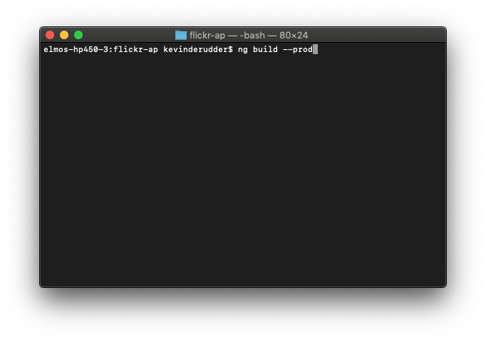
Build for production

